Slide 1
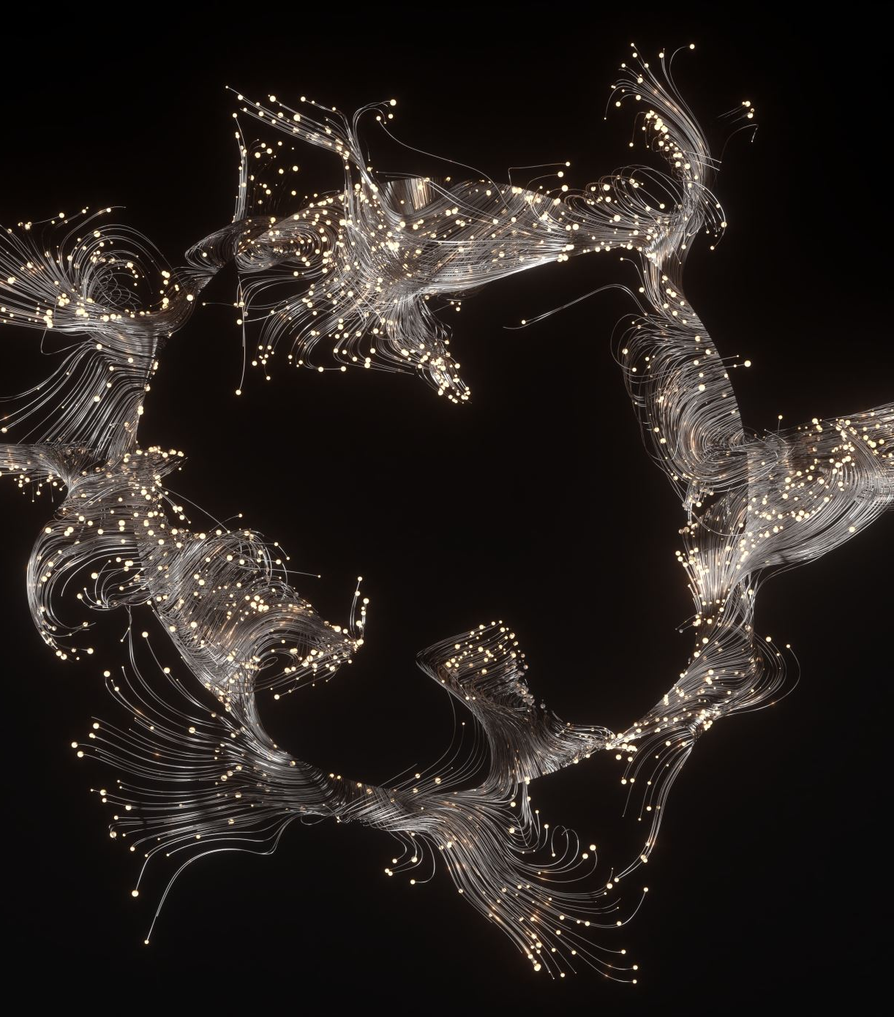
Swarm Choreography Formation Control and Shape Design
By Oz Arye and Arnold Cheskis

Slide 2

Why is it necessary?
In intricate situations, where human hands cannot reach, or a scan over a large area is required, by connecting multiple drones to the same network we can then harness the capabilities of artificial intelligence to handle complex tasks and fulfill them successfully.

Slide 3
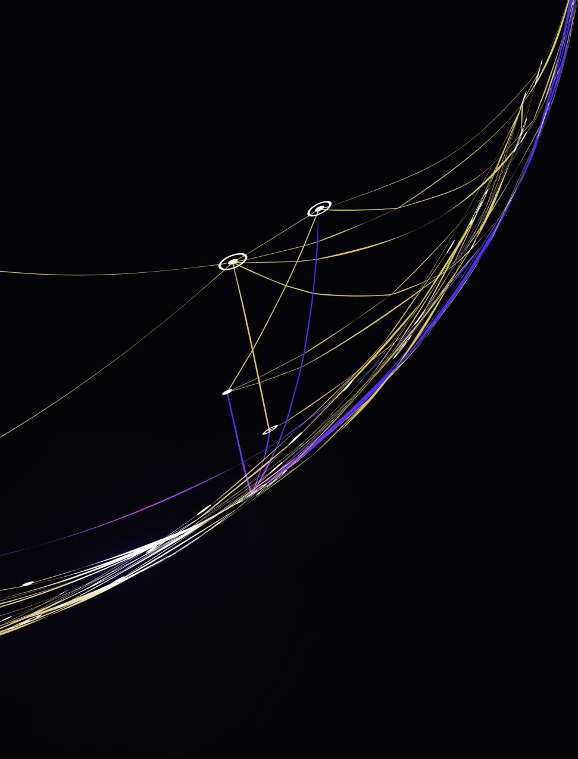
Our mission
The goal of our project is to synchronize a given number of drones, that communicate through a UDP network, by using artificial intelligence that instructs them move in a given closed path (e.g., a circle, triangle, etc.). This interface receives an image of a closed path as input and makes the drones move on it without collision. This can be used to scan an area or in rescue missions.

Slide 4
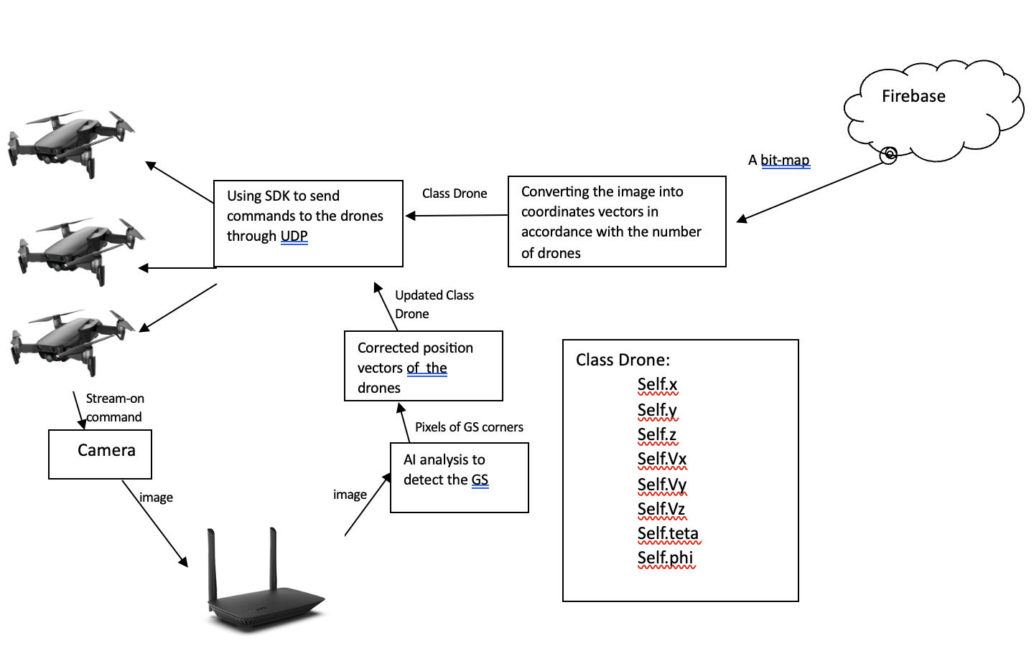
System overview
We start with the user, who provides the image via Firebase, and then we convert it to coordinate vectors that determine the possible locations of the drones. The class Drone is created for each drone for that purpose. Then the drones stream back via the router what they see and the AI analyzes the image.

Slide 5
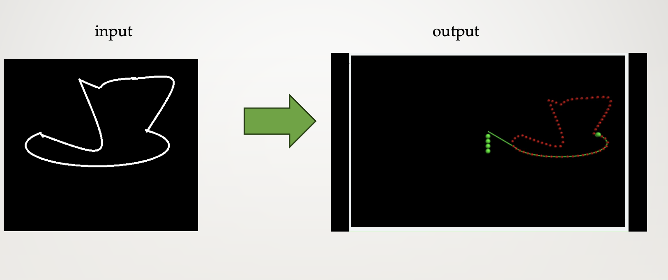
The input can even be a drawing The output – coordinates for the drones

Slide 6

How it would look

Slide 7
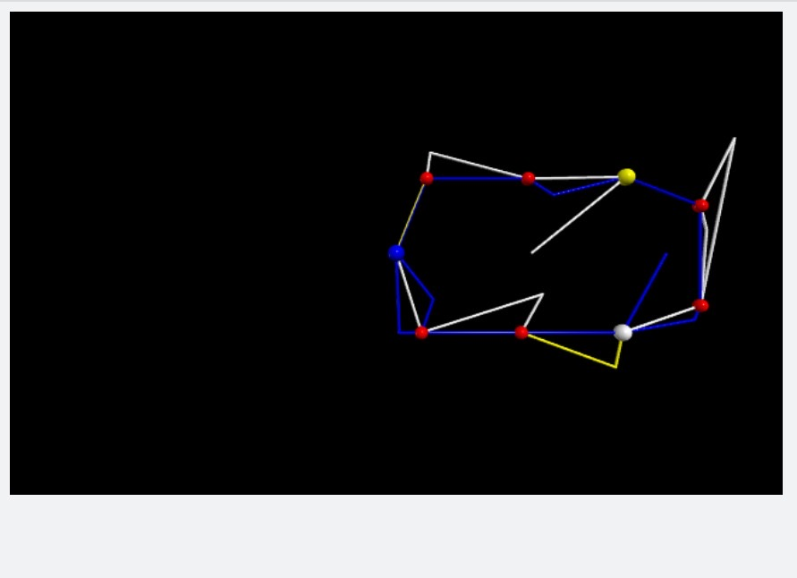
The result
A synchronous move of several drones, which we may name “a swarm”, that is stable and does not collide, even when it’s disrupted by external forces!

Slide 8
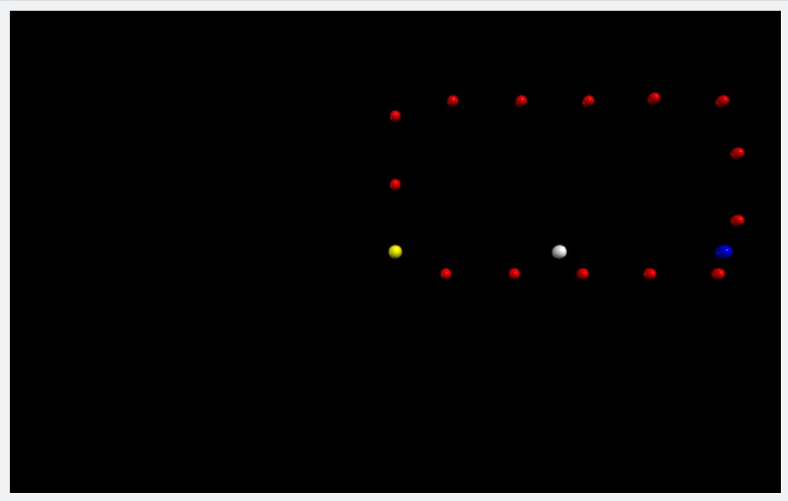

Slide 9
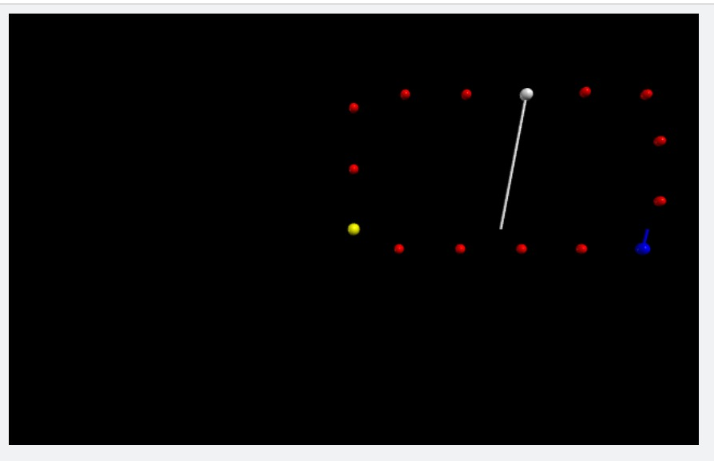

Slide 10
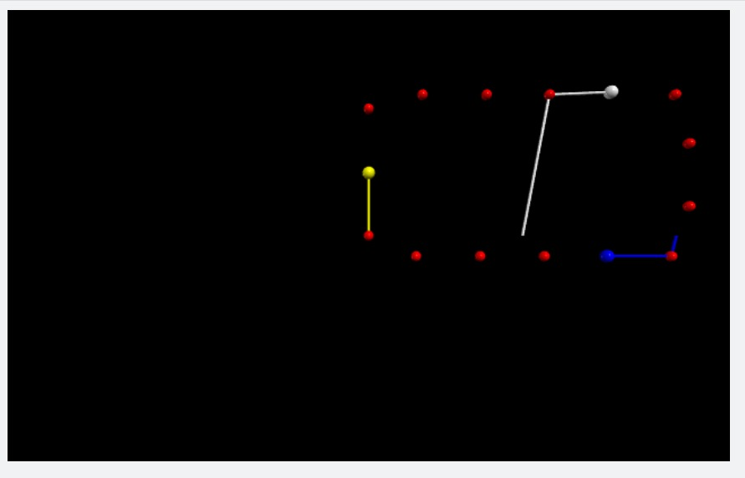

Slide 11
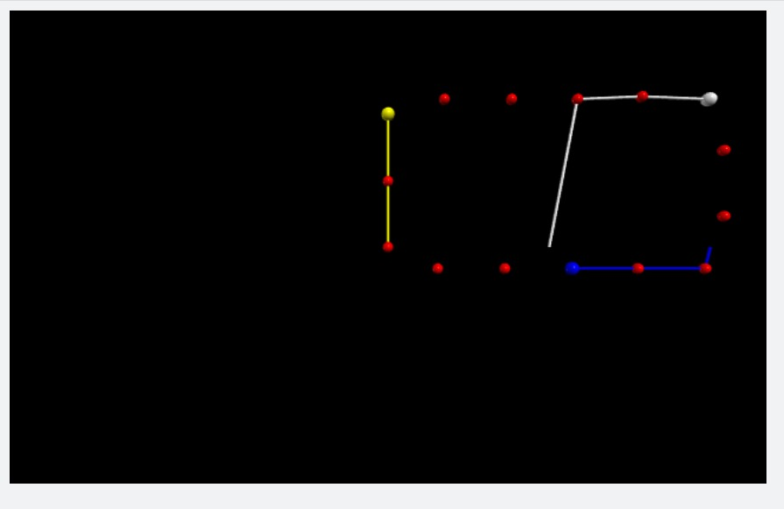

Slide 12
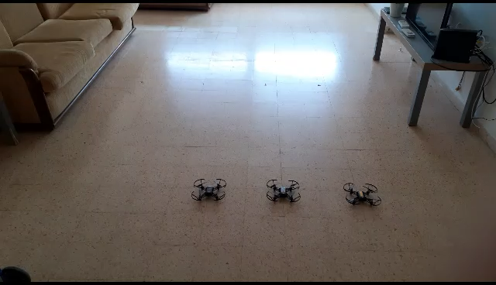
A short demonstration

